Slide 1
National Federation of Paralegal Associations 2019 Joint Conference Denver, CO April 26 -28, 2019
Presentation by: Colleen O’Gorman, Policy Director,
KCPA Board of Directors
September 11, 2019

Slide 2
MISSOURI BAR ASSOCIAITON
“A paralegal is a person who is qualified through education, training or experience to perform legal work under the direction and supervision of an attorney.”

Slide 3
PARALEGAL SCHOOL/PROGRAMS – Professional Development
•ABA approved
•AAfPE – American Association for Paralegal Education
•The Judge Advocate General’s Paralegal Credentialing Program
•Other

Slide 4
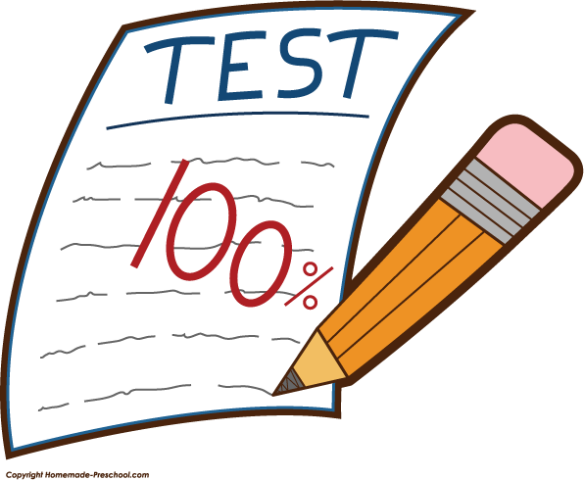
CERTIF * * *
CERTIFICATE
A certificate is awarded upon completion of an educational program.
VS
CERTIFIED
A Certified Paralegal, *CRP, has successfully completed an exam or met other requirements of the certifying organization.
* a NFPA award

Slide 5
Benefits of Certified or Registered, to Your Firm and the Community?
Paralegals are a profit center for a firm.
They increase the efficiency of the legal team and firm.
They enhance the ability to a firm to provide more pro bono legal services.
They help fill the Judicial Gap.
Consumers want their services.

Slide 6
Paralegal Certified/Regulation/Licensure
WHAT SHOULD KCPA KNOW AND CARE ABOUT?
These are our peers;
It is the role of a professional organization to raise
up local standards. We must take ownership of this task;
Credibility – ‘Certified’ demonstrates knowledge based skills required to pass an exam;
Makes for a stronger profession and professionals.

Slide 7
Exams:
National Federation of Paralegal Associations – NFPA
Paralegal Core Competency Exam (PCCE)
Paralegal Advanced Competency Exam (PACE)

Slide 8
You are accountable for your own success . . . Career management requires quality networking, being in the right place at the right time, earning a voice at the table, knowing your unique value proposition and how to use it.
Glenn Llopis, Forbes.com

Slide 9
MARKETING YOUR CREDENTIALS
•Become an expert
•Improve your speaking skills
•Speaking engagements
•Participate in panels, committees, boards
•Write articles or opinion papers
•Network

Slide 10
MARKETING YOUR CREDENTIALS
•Resume
•Linked-In and other social media
•Partner with your firm
•Partner with your Association
•Mentor new Paralegals

Slide 11
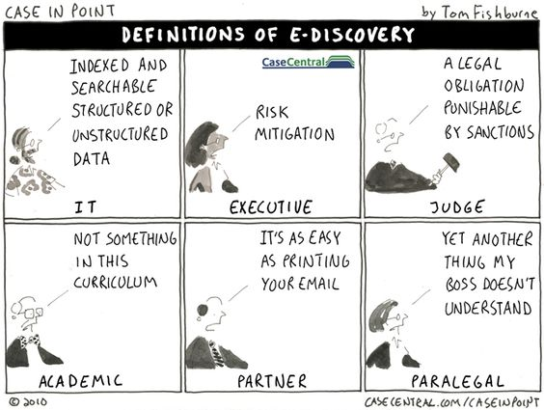
eDiscovery

Slide 12
eDiscovery
Important Things We Must Know:
Model Rule 5.3
Sanctions are coming
Missouri and Kansas are 2 of the 36 states that have adopted the Duty of Technology competence
Education and Certification is available – CED
Sedona Guidelines

Slide 13
The Judicial ‘Gap’
What is it?
Who does it effect?
Where are the solutions?

Slide 14
QUESTIONS???
ANYONE, ANYONE???
Colleen M. O’Gorman
KCPA Policy Director
Senior Paralegal
Kansas City Public Schools – Legal Services
cogorman@kcpublicschools.org

